Slide 1
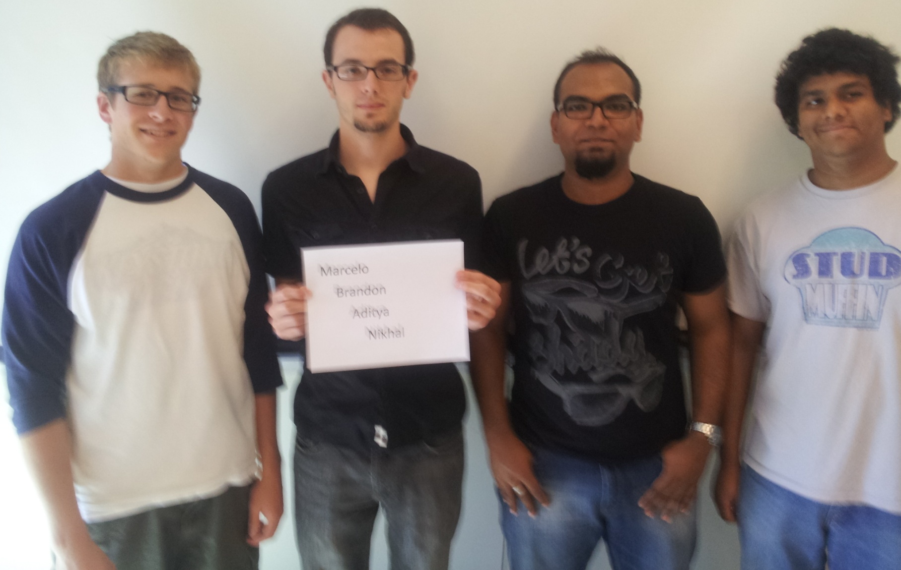
THE INCREDIBLE HUD
MARCELO L. BRANDON G. ADITYA B. NIKHIL S.

Slide 2
Outline
Project overview
Project-specific success criteria
Block diagram
Component selection rationale
Packaging design
Schematic and theory of operation
PCB layout
Software design/development status
Project completion timeline
Questions/Discussion

Slide 3
Project Overview
Helmet-based heads-up display
Displays telemetry data such as speed, direction, temperature, and G-force
Displays image from web camera to implement a “rear view mirror”
The user can select different display modes
An accelerometer, GPS module, and thermometer will generate telemetry data
Data will be recorded onto SD card to allow for future review
The battery pack, motherboard and primary PCB will be located in a secondary backpack enclosure

Slide 4
Project-Specific Success Criteria
An ability to display critical system information via a heads-up-display (HUD).
An ability to measure telemetry information (speed, acceleration, temperature, and GPS) and store it to flash memory.
An ability to maintain portability through the use of a rechargeable battery system.
An ability to enable/disable important features within the display (full information, minimal, on/off).
An ability to plot recorded GPS data on a map while overlaying telemetry information on a computer.

Slide 5
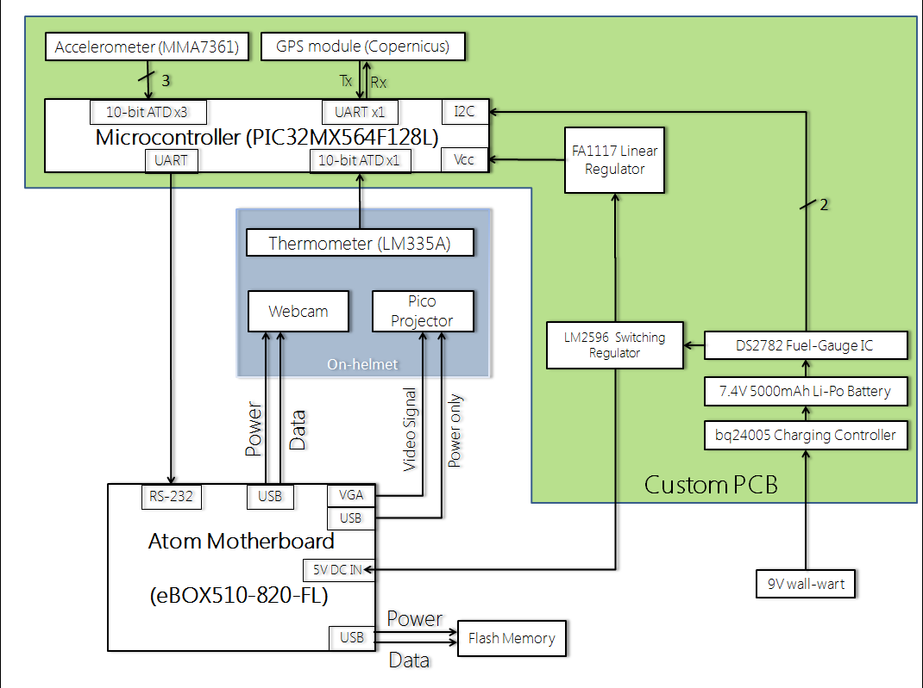
Block Diagram

Slide 6
Motherboard Selection Rationale
Main design constraints :
Small size
Low power consumption
Video-processing capable (VGA output and web camera handling)
Robust packaging (case/shield)
Chose Atom (eBOX510-820-FL)
Met constraints
Pulls 2W, 1.1 GHz clock, and supports UNIX and Windows Embedded 7 with great driver support
Other option was ARM Cortex A8 based Beagle Board
clocks 600 MHz and only supports UNIX with driver support not guaranteed
Has standard packaging solutions – no custom fabrication required
Case doubles as a heat sink

Slide 7
Microcontroller Selection Rationale
Worst-case analysis at start of project:
12 ADC channels for peripherals
At least 2 and preferably 3 UARTs
2 I²C
Enough RAM for lots of buffers
Chose PIC32MX564F128L
Met all constraints plus ‘wiggle room’
Main contender was Atmel line of products
None met all of the desired constrains
Group experience with PICs, especially PIC32
Perfect micro (as of now) PIC24FJ64GA106

Slide 8
Projector Selection Rationale
Design considerations :
Small
Lightweight
USB powered
High resolution (WVGA)
Focused at infinity
Chose Microvision SHOWX+ Laser pico-projector
Met considerations
Completely solid state
Competitor was Optoma PK201 LED pico-projector
Slightly brighter but also 40g heavier
LED projection technology requires manual focusing and has moving parts – less rugged

Slide 9
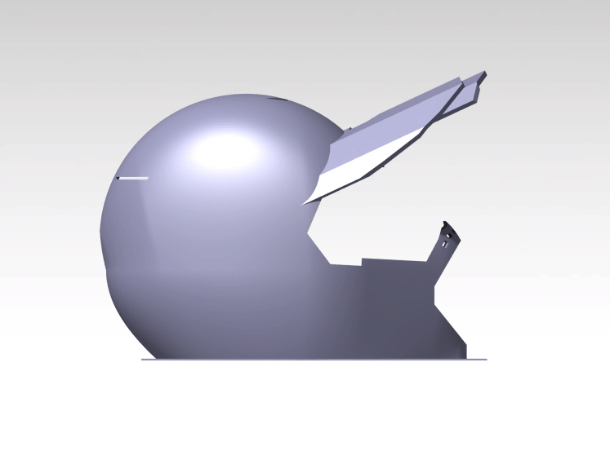
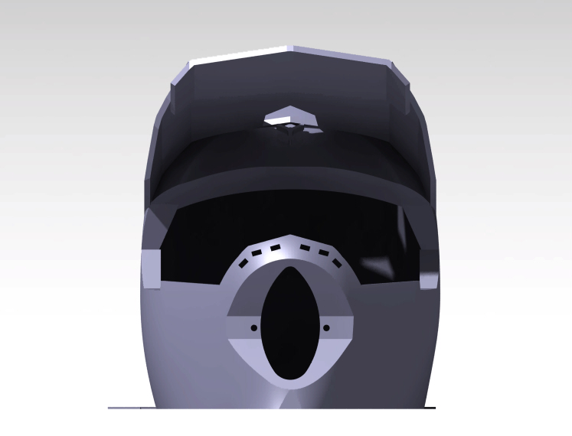
Packaging Design: Helmet
Helmet module:
Projector
Optic glass/lens
Fiberglass visor
Thermometer
Rear view camera
Control buttons
Projector
Combiner
glass
Fiberglass
Projector
Thermometer
Rear view camera
Control buttons
Combiner
glass
Fiberglass

Slide 10
Packaging Design: Backpack
Backpack module:
Motherboard
PCB
Battery
Cooling fans
Promotes mobility and portability
Robust for weather and impact resistance
Streamlined

Slide 11
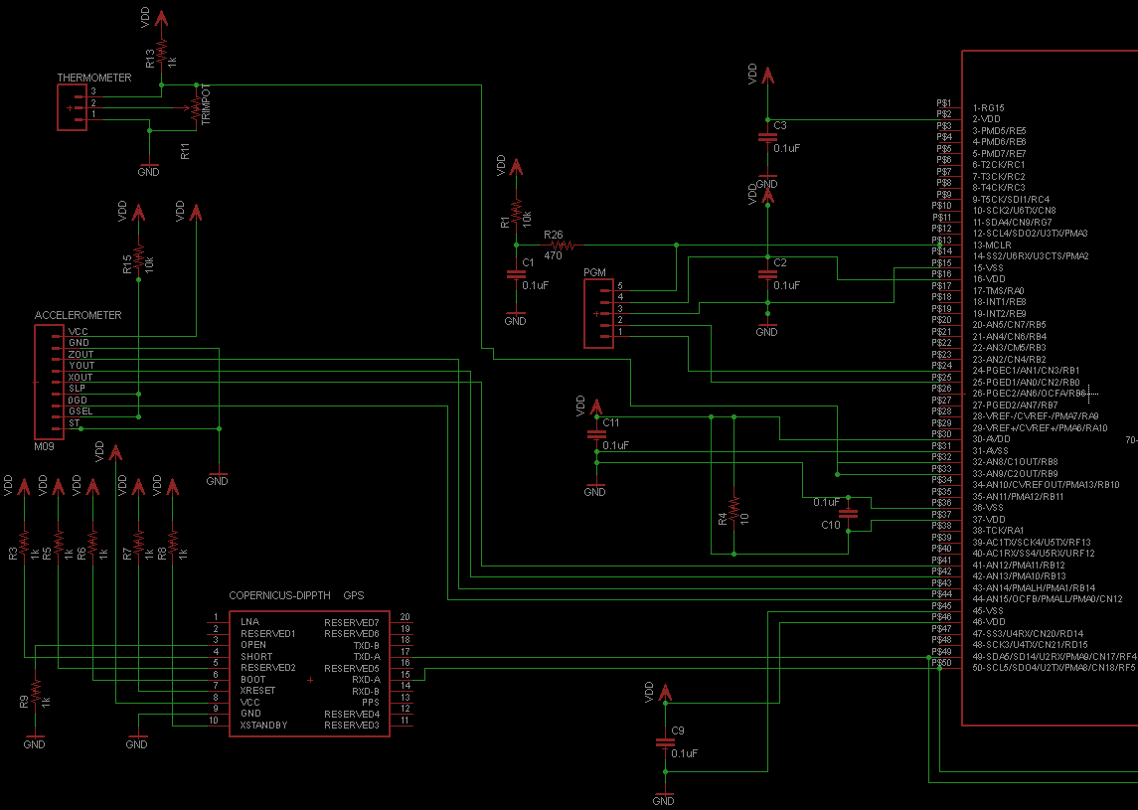
Schematic/Theory of Operation: Peripherals and Microcontroller

Slide 12
Schematic/Theory of Operation: Battery Charging Circuit
Charging Controller

Slide 13
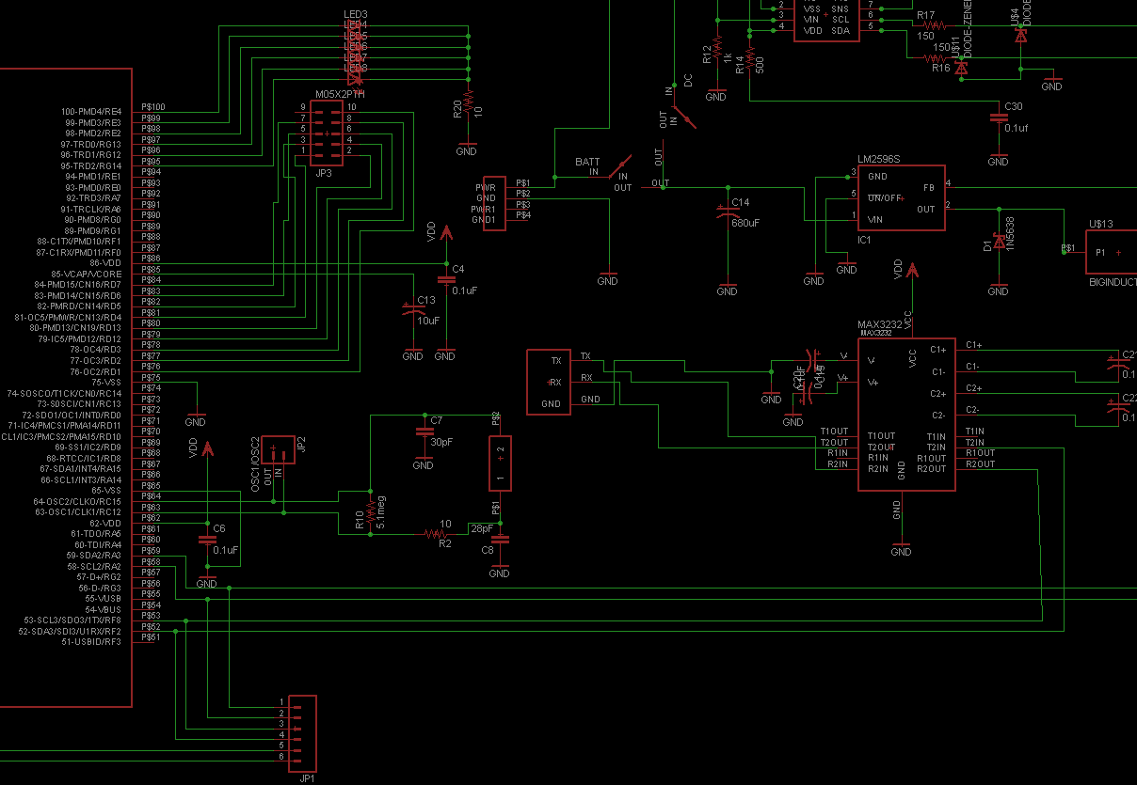
Schematic/Theory of Operation: Peripherals and Interfacing
7.4 - 5V Regulator
Line Level Converter
Oscillator Circuit

Slide 14
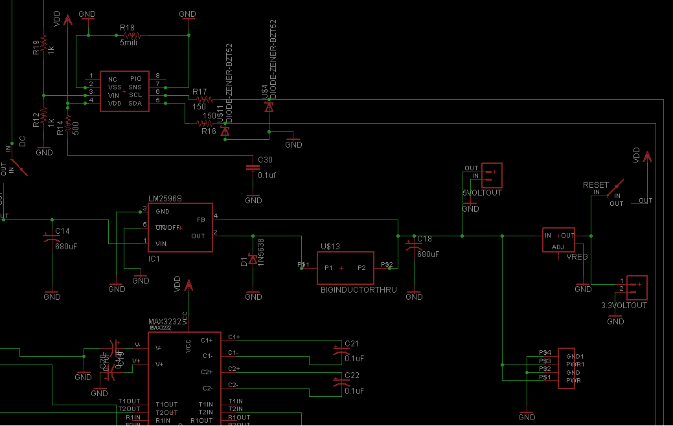
Schematic/Theory of Operation: Fuel Gauge and Voltage Regulator
Fuel Gauge Circuit
5 - 3V Regulator

Slide 15
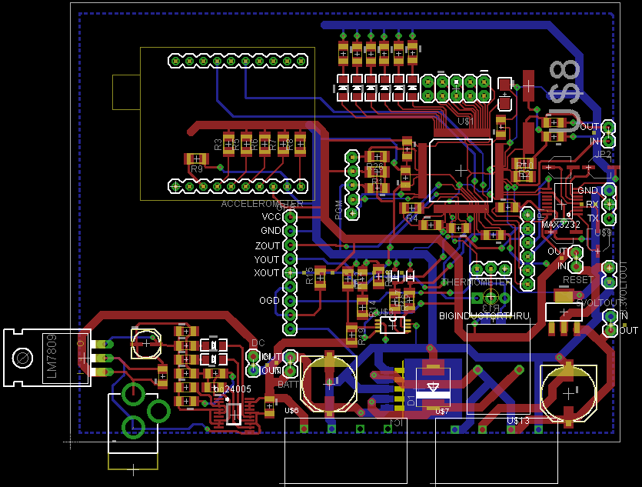
PCB Layout

Slide 16
PCB Layout

Slide 17
Software Design / Development Status
Peripheral Name | Comm. Status | Algorithm | Algorithm Status
PC RS232 Comm. | 1xUART Tested OK | Functions to send data packets and receive interrupt | Implemented Tested OK
GPS | 1xUART Tested OK | Interpretation of packets received + config if necessary | Unimplemented
Accelerometer | 3xADC Tested OK | Conversion of data into g-force measurements | Implemented Tested OK
Thermometer | 1xADC Untested | Conversion of data into temperature measurement | Unimplemented
Charge Counter | 1xI²C Untested | Configuration setup and interpretation of sent packets | Unimplemented (#1 PRIORITY)
Buttons | 7xGPIO 1 Tested | Sampling of buttons + assignment to actions | 1 Implemented Tested OK
GUI elements on Atom | 1xRS232 Untested | Display GUI, receive/interpret packets from PIC32 | Unimplemented

Slide 18
Project Completion Timeline
Week # | Objectives and Milestones
Week 08 | Finish PCB adjustments pending Design Review & Course Staff feedback, prototype battery management circuitry, mockup helmet GUI
Week 09 | Complete PCB Design & send for fabrication, begin intensive motherboard software development, backpack unit specification
Week 10 | Receive PCB and begin population, procure backpack unit housing, further develop motherboard software and helmet GUI
Week 11 | Debug PCB, begin testing on a system level, begin software testing, begin ‘companion application’ development (for logged data)
Week 12 | Debug software and hardware, continue system level testing, continue companion application development
Week 13 | Debug software and hardware, continue system level testing, continue companion application development
Week 14 | Debug software and hardware, continue system level testing, continue companion application development
Week 15 | Debug software and hardware, continue system level testing, continue companion application development
Week 16 | Demonstrate PSSCs and submit final report and poster

Slide 19
Questions ?

